Slide 1
Identity Security
Azure Active Directory
Cheah Eng Teong Microsoft MVP
Notes:
Implement an Azure AD infrastructure including users, groups, and multi-factor authentication

Slide 2
Azure Active Directory (Azure AD)
Microsoft’s cloud-based identity and access management service, which helps your employees sign in and access resources in:
External resources, such as Microsoft Office 365, the Azure portal, and thousands of other SaaS applications.
Internal resources, such as apps on your corporate network and intranet, along with any cloud apps developed by your own organization.

Slide 3
Compare Active Directory to Azure Active Directory
Azure Active Directory | Active Directory
Cloud | On-Premises
Designed for HTTP & HTTPS | Query via LDAP
Queried via REST API’s | Used Kerberos for Authentication
Uses SAML, WS-Federation, or OpenID for authentication | No Federated Services
Uses OAuth for autheration | Organizational Units (OU’s)
Includes federation services | Group Policy (GPO’s)
Flat Structure

Slide 4
Administrator role permissions in Azure AD
Using Azure Active Directory (Azure AD), you can designate limited administrators to manage identity tasks in less-privileged roles.
Administrators can be assigned for such purposes as adding or changing users, assigning administrative roles, resetting user passwords, managing user licenses, and managing domain names.
The default user permissions can be changed only in user settings in Azure AD.

Slide 5
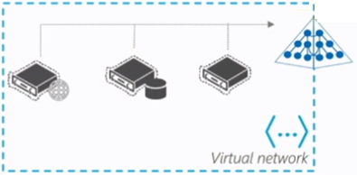




Azure AD Domain Services
Managed domain available in your Azure VNet
Automatic background sync to your managed domain
Automatic background sync to your on-premises domain
Azure AD
Connect
Active Directory
Azure AD
Domain Services
Azure Active Directory
Workloads and apps in IaaS
Simplified deployment experience
Integrate with Azure AD
Use your corporate credentials/passwords
NTLM and Kerberos authentication
High availability
Notes:
https://docs.microsoft.com/en-us/azure/active-directory-domain-services/overview

Slide 6
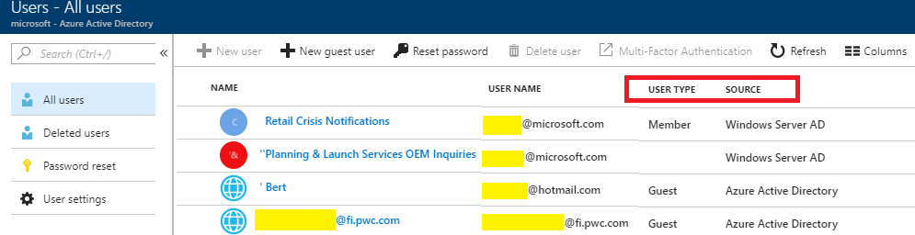
Azure AD Users
Azure AD defines users in three ways:
Cloud identities
Directory-synchronized identities
Guest users

Slide 7
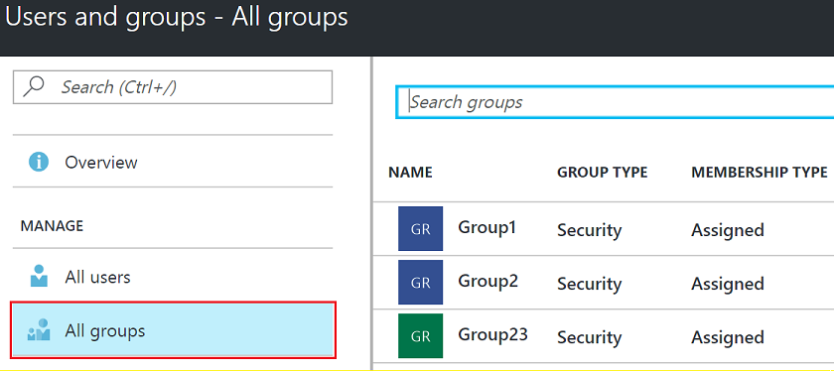
Azure AD Groups
Azure AD allows you to define two different types of groups:
Security groups
Office 365 groups

Slide 8
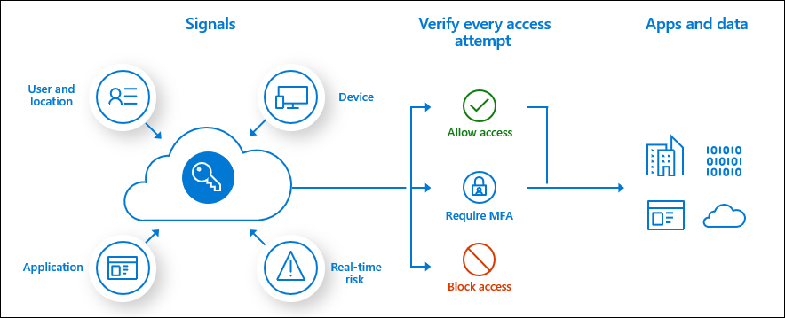
Azure MFA Concepts
Authentication methods include:
Something you know (typically a password)
Something you have (a trusted device that is not easily duplicated, like a phone)
Something you are (biometrics)

Slide 9
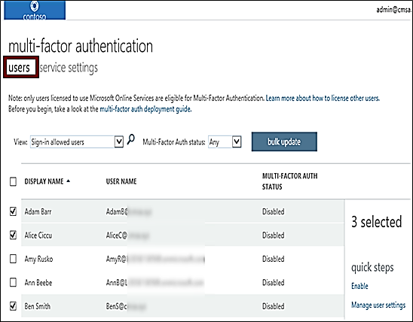
Enable MFA
Select the users that you want to modify and enable for MFA
User states can be Enabled, Enforced, or Disabled
On first-time sign-in, after MFA has been enabled, users are prompted to configure their MFA settings
Azure MFA is included free of charge for global administrator security

Slide 10
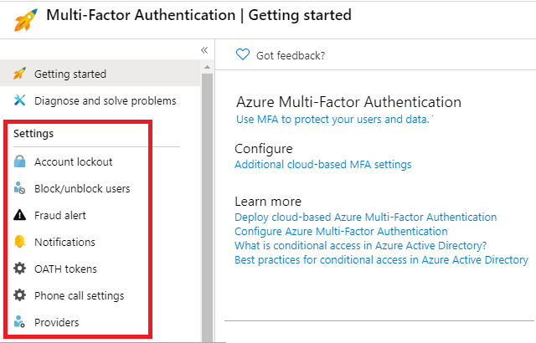
MFA Settings
Account lockout
Block/unblock users
Fraud alert
Notifications
OATH tokens
Phone call settings
Trusted IPs
Notes:
https://docs.microsoft.com/en-us/azure/active-directory/authentication/howto-mfa-mfasettings

Slide 11
Demo

Slide 12
References
Microsoft Docs

Slide 13
Thank You

